Slide 1



Tabletop Role-Playing Games at Work for Fun & Profit
Nina Navazio
Content Designer
Deepti Vaidyanathan
Software Engineer
William Assaf
Senior Content Developer
Notes:
**Reminder to Start recording**
<nina>
Welcome everyone!
William: I’m the content developer for Learn content on the database docs team, and I work on Learn content for Azure SQL Database, Microsoft Fabric Data Warehousing, SQL Server performance topics, data virtualization, and a variety of other topics. And I’ll add that while it’s not our job, we do all play D&D at work friends here at Microsoft as part of an employee group here, both online and in-person games, and if you were to tell 12-year old William that he’d be running D&D at work, he’d think that be pretty rad. Back to you Nina.

Slide 2
What’s inside
Tabletop role-playing games (TTRPGs), like Dungeons and Dragons, are co-operative storytelling games.
What can we learn about communication, teamwork, and diversity from TTRPGs?
Legal Stuff: This content and group is not affiliated with, endorsed, sponsored, or specifically approved by Wizards of the Coast LLC. Dungeons & Dragons® is a trademark[s] of Wizards of the Coast. For more information about Wizards of the Coast or any of Wizards' trademarks or other intellectual property, please visit their website at (www.wizards.com).
Notes:
<nina>
Tabletop role-playing games, like Dungeons and Dragons, are co-operative storytelling games. In this talk, we'll chat about TTRPGs and some of the lessons we can learn from them to not only help us improve ourselves, but also to improve hard and soft skills we can use at work, like professional communication, teamwork, and the importance of diversity. So we're talking about table-top role-playing games at work for fun and for profit, to improve our practical communication at work.
We're going to explore a lot of parallels and metaphors. Once we got thinking about it, there really are a lot of translatable skills and abilities. If you've played before, we think that you will start to see the many parallels and practice skills you use in both dungeons and meetings.
<click>

Slide 3
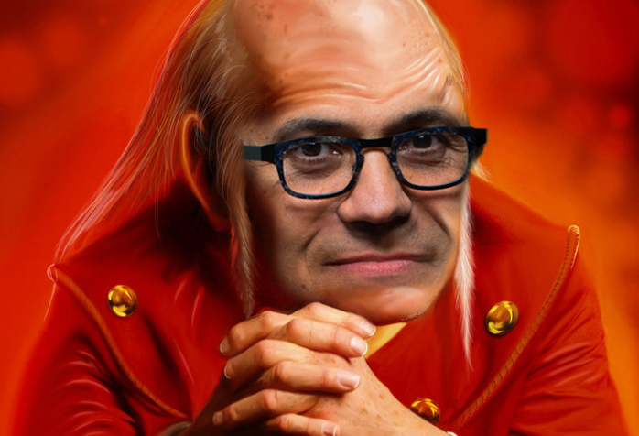
Agenda
Teamwork
Professional Communiation
Diversity
Design Thinking
Q&A
Notes:
Here’s our agenda for today.
We'll start with Team work, then move on to professional communication, diversity, and design thinking, and then finally Q&A.
<pass to william>

Slide 4
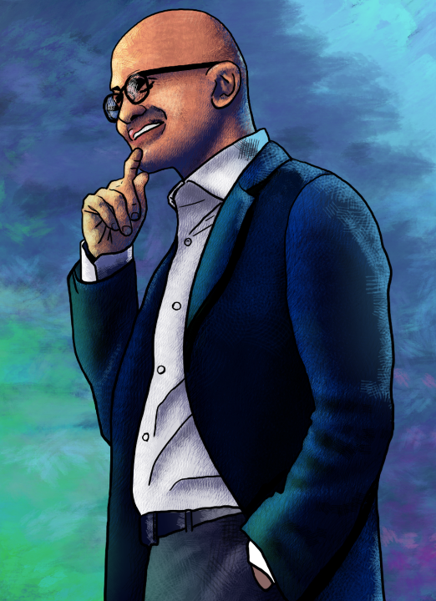
Innovation with Empathy
“Innovation comes from having a deep sense of empathy.”
Satya Nadella
Notes:
<william>
But before we jump into the whole presentation, I'd like to take a moment to discuss the thesis of our presentation today, empathy. Empathy has a role in both playing games as well as business. Here at Microsoft, Satya wants us to operate not just with empathy for employees, but empathy for our customers, and our customers’ customers too. This is a crucial concept for Satya's Microsoft, best said by Satya himself:
“Innovation comes from having a deep sense of empathy.”
And that's really what all the stuff we'll talk about today boils down to: how you CAN learn empathy, perhaps, in the safe environment of a TTRPG.
I’ll hand it over now to Deepti to get us started with an introducing to TTRPG’s and what we can learn from them:
<pass to Deepti>

Slide 5
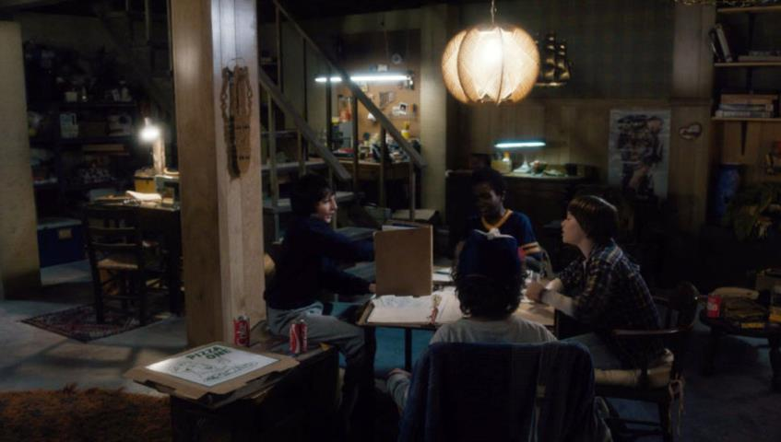
What is a tabletop role-playing game (TTRPG)?
Stranger Things (season 1, episode 1)
Notes:
<Deepti>
So what is a TTRPG?
At their most basic level, TTRPGs bring people together to improvise a story. You've probably seen photos like this one before. These are characters from Netflix's Stranger Things playing Dungeons and Dragons, and while usually table-top roleplaying games like this take place at a literal table-top, these days we also play it online with a virtual table-top, but the game and roles stay the same.
There are two roles people play within the group: the Players, <click> and the Main Storyteller <click> (also known as the Game Master or GM, but here we’ll use the phrase Main Storyteller).
In this image, the Main Storyteller has a book propped up in front of them and many resources they're using to help tell a story, and all the players have papers and binders in front of them to keep track of information about their characters.
Nina

Slide 6
Roles in a TTRPG
Player
Main Storyteller
One of the main characters.
Has agency in a sandbox.
Doesn’t know what’s next.
Makes decisions “in character” based on “character knowledge” not player knowledge.
Co-creates the world and plot.
Improvises within fictional world.
Helps tell the story.
All other characters in the world.
Manages the sandbox.
Prepares for what could be next.
Makes decisions consistently, based on knowledge of the world and events to come.
Co-creates the world and plot.
Improvises within fictional world.
Helps tell the story.
Notes:
<nina>
To get a little more specific, here’s a quick breakdown if you’re new to the concept of a table top role playing game.
<click>
Each person has one responsibility: playing one character in the world. These are the “main characters” of the story, <click>
they have agency in the sandbox of the world, <click>
and while they don’t know what happens next in the story, they have a large degree of freedom to make decisions in this fictional world. <click>
They make decisions by playing the role of character, and because it’s fun, players often separate their “character’s” knowledge from their own player knowledge for some situational irony and often comedy.
On the other hand the Main Storyteller has more responsibilities: <click>
They run the entire world and all its other non-player characters, <click>
manage the goings on of the sandbox and its plot,<click>
prepare for the many possible decisions the players could make, <click>
and make decisions consistently about rules and story.
The Main Storyteller is a referee in some cases, but not necessarily an adversary or opponent. Though Main Storyteller does play as the enemies of the players in combat situations.
The Main Storyteller has an idea of the fictional world in their mind, and they create mysteries, monsters, and marvels throughout the world. But the Main Storyteller doesn’t do this alone. <click>
Since the player’s characters have their own agency, the Main Storyteller must balance their storytelling job with refereeing. Both roles co-create in the world. <click>
If a player does something unexpected, what happens next? Both roles improvise within the fictional world.
The Main Storyteller is tasked with both enabling creativity and cooperation, as well as providing the challenges, but everyone in the world helps tell the story. <click>
Everyone at the table works together to design goals, to agree on and follow rules, and to provide the psychological safety that fosters innovation and fun.
Now that we’ve introduced role-playing games and the metaphor we’ll be using today between gaming and business, I’ll turn it over to William to talk about Teamwork.

Slide 7
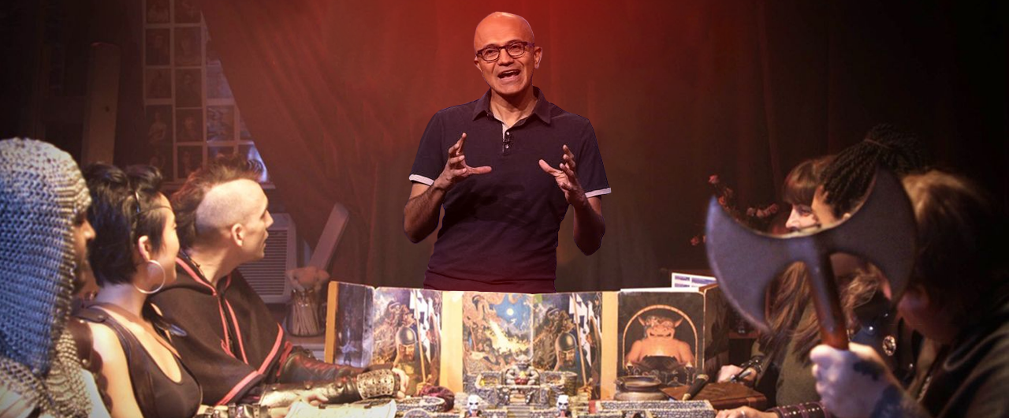
Teamwork
Teamwork | Professional Communication | Diversity | Design Thinking | Q&A
Notes:
<william>
Let’s talk about what we can learn about team dynamics from tabletop roleplaying games, including the value of veteran leadership, team motivation, problem solving, and conflict resolution.

Slide 8
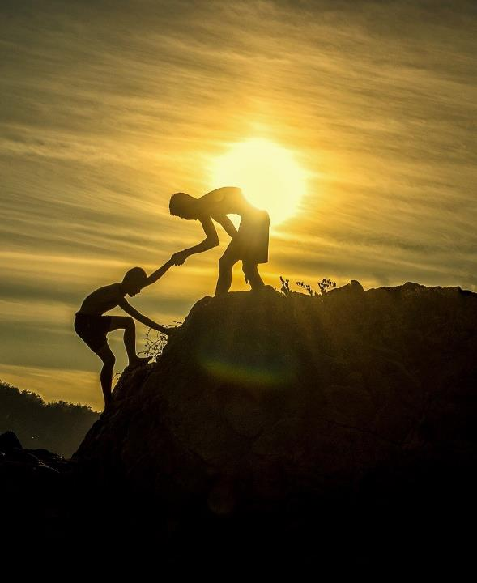
Veteran Leadership
Avoid knowledge bottlenecks
Tone and tenor, model behavior
Demonstrate freedom to innovate
Notes:
<william>
Here’s where we get into some of our favorite parallels between professional teamwork and cooperative storytelling at the gaming table.
<click>
First, Good teams combine veteran leadership with newcomers.
When playing a TTRPG, the Main Storyteller could easily become a bottleneck for new players. If new players ask only the Main Storyteller about game rules, everyone suffers because the game slows down. But if veteran team members are present, willing, and able to help newcomers, then the load is distributed around the team. The Main Storyteller can focus on guiding the story while veteran team members show new players the ropes.
On an engineering team, a single manager or even a senior technical lead will become a bottleneck for questions and how-to's. It's better if more experienced members of the team, even if they aren't technical leads or principal architects, are able to walk devs through organizational processes, including codebases and architecture.
Team members might not feel comfortable asking "dumb" questions all the way up the chain, and would rather use a peer as a sounding board. Not to mention that this also saves the Manager and Main Storyteller a lot of time.
<click>
Veteran players help establish the accepted tone and tenor of the gaming table and the status meeting. They show not only how to roll the dice, but veterans model behavior. They demonstrate how to interact with the others, how to make requests, where to get the good coffee. Show don’t tell. That kind of info doesn't need to come from management, but regardless new players and team members still need to know it. But most importantly,
<click>
Veterans have the burden and the privilege to be exemplary, to demonstrate the freedom to be creative. That freedom is not something that everyone understands right away … teams should demonstrate empowerment to innovative, and build on each other’s successes.
Meanwhile, if you are in management of a team, or the Main Storyteller of a gaming table? Don’t you dare stand in the way of creative freedom - by laying down arduous rules, putting up walls to communication, or single threading the flow of information through yourself. That just makes more work for you, and less fun for everyone else.
<pass to Deepti>

Slide 9

Motivation
Creative work is intrinsically more motivating
Allow for process ownership and creativity
Empower creatives
Notes:
<Deepti>
A team still needs to be motivated, and heuristic or creative work is intrinsically motivating.
The Main Storyteller provides an entire world for the players to explore, and ideally plenty of plot hooks for players to feel like their creative decisions matter in the scope of the story. In my job as a software engineer, I find myself drawn to tasks like working on design documents and bringing those designs to life in code, because I get to flex my creative muscles and I feel invested in the outcome of whatever solution I make.
Don't tell your team that they must to do x y and z. Tell them they need to get to z, and let them explore the possibilities of how to get there. Whether it's resolving a bug or slaying a dragon, think about the quests in your workplace or gaming table. Learn to recognize where constraints disincentivize innovation and creativity.
<click>
When leading a team or a gaming table, make sure to allow teams to have some ownership over creative processes. By doing so, you’re helping your team feel invested in whatever you’re working towards, whether that’s avenging a fellow player’s fallen family or designing a new feature in a product. Don't do all the creativity for them. Can you imagine how boring of a game it would be if the Main Storyteller was performing a monologue about how each character made these exact choices, to slay the dragon in this particular way, with these specific spells, and holding the sword in this particular way?
<click>
Too often, our workplaces and gaming tables talk a big game about creativity and innovation, then immediately stifle it with rigid processes or old rules or poorly run meetings that waste everyone's time.
Instead, we should strive for supportive, co-operative, and creative teams and tables that let each member explore their ideas. Because more often than not, by letting the team find their own way on the path to Z, they will find solutions that you never even considered before, and that is where innovation starts.
Nina

Slide 10

Problem Solving
Emphasize creative motivation and how to solve problems
TTRPGs abstract problems, so we can easily learn & see solutions
Notes:
<nina>
Not only do TTRPGs emphasize the need for creative motivation, but it also lets us practice a muscle we use basically every day: problem solving.
Our real-life problems, like how to deliver a project on a timeline, can seem huge and overwhelming. But a side-quest to deliver a flower by a certain deadline to an Earl? Now that's exciting. TTRPGs can act as an abstract filter for our everyday worries—and help us figure them out in a safe space where it's OK to not deliver on time, but at the same time learn how we could've delivered and what we'll do better in the next quest. <click> Instead of feeling pressure from other teams, managers, or third parties, in a TTRPG you only feel pressure from... dragons, or Queens, or the imminent collapse of some mountain top you're on. These problems are still real, but it's much easier to take a step back and ask, "What should my character do?" Instead of getting caught up in all the emotions and stressors that would realistically overwhelm someone in a situation like that.
By practicing that skill of stepping back and asking, "What should I do here?" as well as working with your fellow players to figure out exactly what you should all do as a team, you are getting better at the transferrable skills TTRPGs are so good at teaching.
<Deepti>

Slide 11
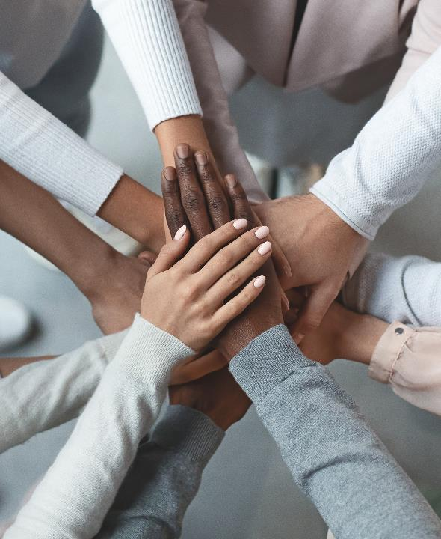
Conflict Resolution
Remind team of goals
Balance open discussion with decisiveness
Emphasize empathy
Notes:
<Deepti>
Co-operative and creative teams are almost never in constant agreement, and whether your team is trying to infiltrate a castle or collaborating on a project there are bound to be some disagreements.
<click>
Often people can be so attached to their idea that they can't see how any other solution could also work, but as a leader its important in that moment to remind the team of their ultimate goal. As the Main Storyteller, if the PCs are getting a bit heated deciding how to fight the BBEG, you can remind them of what the ultimate goal of every TTRPG is: to tell a cool story together. A reminder of this shared goal also reminds them that there isn't a single solution to whatever problem they're facing, as long as they're having fun they're "winning" the game! In work settings, disagreements can often arise in design meetings where the goal is to achieve some sort of consensus and gain clarity on next steps. Reminding your team of this can ensure that everyone is working towards the same goal.
<click>
Whether you’re a Main Storyteller or a manager, you can help lead your team through conflicts by balancing open discussion and decisiveness. To ensure everyone has a voice at the table, its important that you understand how the power dynamics within your team may impact member participation. The new player at a table may not want to voice dissent against an experienced player’s plan, and similarly it can be difficult for a new-hire to question a more senior member of their team during a discussion. In the workplace I’ve seen the Teams hand-raise feature and anonymous feedback during sprint retrospectives be leveraged to encourage participation from those who might have been otherwise hesitant to do so.
While making space for discussion is important, it is equally important to ensure the conversations are leading to some sort of decision. If your players are in combat and one of them is taking a bit of time to discuss their plan with their fellow players, is that alright? Sure! Should it take 30 minutes? Probably not! As the Main Storyteller you can remind them of what the stakes are if a decision isn’t made, and similarly as a manager you can make the most out of yours and everyone else’s meeting time by steering the discussion towards achieving an actionable decision.
<click>
Whether you’re in the middle of a conflict with a co-worker or fellow player, it can sometimes be difficult to see past your own perspective. Everyone at your gaming table and on your team play a part in promoting empathy for each other. As a Main Storyteller or manager, you can start the conversations within your group or facilitate conflict resolution as a neutral party so that people can talk TO each other, not AT each other. As players or co-workers, we can check in with each other regularly and practice empathy ourselves, which we’ll speak to more later in the presentation.
Now I’ll pass it off to William to elaborate on how TTRPGs can help all professional communication

Slide 12
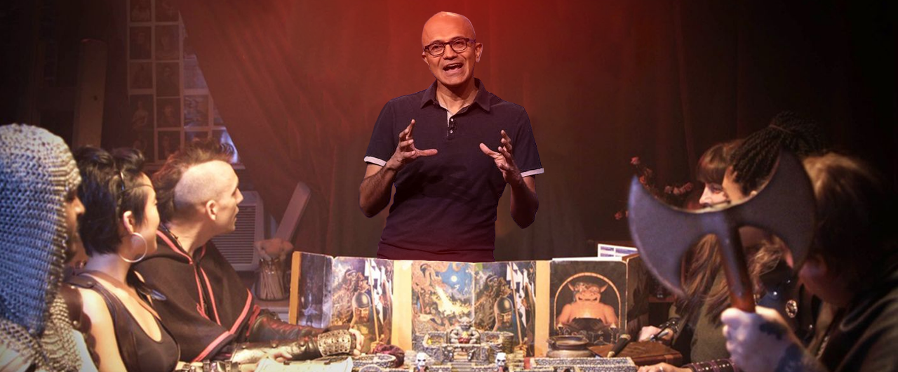
Professional Communication
Teamwork | Professional Communication | Diversity | Design Thinking | Q&A
Notes:
<william>
Being an engaging presenter is a valuable life, work, and gaming skill.
Running and playing at a gaming table with friends since I was ____ helped me develop a comfort level with my own voice, with improv, and the ability to react to sudden redirections.
Most importantly, it gave me experience with preparation, both before the event with my notes, and organizing my thoughts right before I need to say them.
While delivering presentations, as when playing a game with friends, you want to keep everyone engaged and involved. Storytelling is universal, and everyone loves a good story.

Slide 13
Preparing to Improvise
Prepare to deliver
Be humane
Practice, Practice, Practice
Know your audience
Notes:
<william>
As the Main Storyteller in a role playing game, the last thing you want to do is <robot voice> read monotonous, verbatim texts to your table, </robot voice> or to worse, come across as disorganized and disjointed. You want to seamlessly deliver descriptions of anything, even if you’re making them up on the fly. As a player, you want to be creative, and improvise solutions to the problems in the game, more than just swinging a sword.
<click>
As a professional communicator, much of the same applies. Organizations like Toastmasters provide ways to practice your professional communication and public speaking skills in a constructive environment.
But if that's not your thing, you can learn similar lessons through TTRPGs. As the Main Storyteller, by running a table and keeping everyone engaged, you're practicing similar skills that you need when running, say, an executive pitch meeting.
We’ll talk more about practice later, and how it’s important to developing the skills to engage innovation with empathy.
Some of the skills include, first off, being humane.
<click>
Bio-breaks every hour. Just because you can stand and filibuster for 3 hours straight, doesn’t mean they can listen that long.
For virtual arenas, video chat is extremely important. You're missing a lot of information without every human on video. Nobody in the history of communication has ever liked speaking into a speaker phone. Conference calls tends to favor those who already have the loudest voices or most powerful roles. Like __Deepti___ mentioned earlier, in Microsoft Teams, the hand-raise feature is important and an equalizer for these power disparities. <click>
Finally, you must always prep for your audience, and tailor your content and delivery to suit. At the gaming table, some players will be motivated by lots of political intrigue and role-playing, or maybe solving puzzles and riddles, while some are most into combat and looting treasure. Similarly, some folks in an executive brainstorming session or planning presentation are all about the bottom line, some are about building future-proof solutions, and some are about feature integrations with existing systems. You should know who is motivated by what.
In some business conversations, for example, Sales/Ops, the sellers will be most concerned about closing deals and ops leadership will be more concerned about delivery, staffing. We need to know where everyone is coming from.
How can you make sure your pitch appeals to each?

Slide 14
Leaders and Managers
The new employee experience
Progression is important
Priorities, from Low to High
First impressions are important.
Everyone should know what it takes to level up.
Hierarchy of needs Freedom to create.
Notes:
<william>
Whether you are team lead, a manager, or the Main Storyteller of a tabletop game, there are a lot of things we can do to help our team members have smooth onboarding, career progression, and top performance.
So, let’s talk in this slide about what can we learn from leading games that prepare us for leadership at work.
<click>
Starting a new job, especially at a big company like Microsoft, there's so much to learn and do, onboarding can feel like an avalanche of information. Similarly, a new player at your table may feel an overload of new game system rules, lore, and backstory to consume. In each case, it can be overwhelming and dissuading. Let’s try to remember what it was like to join a new gaming table or start a new job, and empathize with the onboarding stress. Having reasonable expectations for new employees on your team or players at a table is important. Allow for time to onboard, and specifically make an effort to focus on onboarding for someone new. This is part of a good first impression for both an employer and a gamer.
By the way, even before the hire, the candidate interview experience is also super important. If you interview someone for hours across multiple days and require a presentation and homework and watching a video and read a book, and then you don’t hire them, that doesn’t reflect well on you, certain rocket company who will remain unnamed. Similarly, you could easily turn off new players to your gaming table by overloading them with homework, coming across as haughty, unapproachable, super intense, or picky and critical. So, practice a patient pitch to newcomers... both your employees and your players.
<click>
In our careers as well as player characters, understanding the ladder of progression is important. Making sure newcomers know what it takes to get promoted, or level up, is part of rewarding and incentivizing the good behavior. Making sure players know how higher-level characters grow is important as well. In each case, teammates should help each other grow and foster desirable growth attributes, so that the whole team advances together. Creating a competitive or cutthroat atmosphere in a team at work makes about as much sense as it does at the gaming table - it doesn’t. Does anyone enjoy being at a tabletop with someone who just wants to lie, cheat, or steal from eachother? Can you imagine if player characters were constantly backstabbing each other? How would they ever slay a dragon?
<click>
Finally, the hierarchy of needs. For the unfamiliar: something that’s discussed in any management course, there’s this theory of needs that Maslow and others before him theorized. There's a hierarchy of basic human needs. If you want team members to succeed, you need to make sure their needs are met. At the bottom of the needs are the most basic physiological needs: food, water, shelter, sleep, etc. These basic needs will always disrupt the highest order priorities… those that involve innovation and self-actualization. On that hierarchy of needs is both physiological and psychological safety … near the top is a sense of belonging - these are required before we can become our ideal selves, ideal teammates, or champion dragonslayers.
At work, this is why companies have benefits and competitive salaries, and an emphasis on work-life balance. It’s why affordable housing is important, it’s why paid time off and parental leave is necessary.
At the gaming table, sure we have snacks and comfortable chairs, but also, we value each player's freedom to be creative … without being made fun of. Freedom from teasing or infighting or harassment or unwelcome propositioning.
We'll talk more about the importance of psychological safety later, and why it is often taken for granted.
I’ll turn it over to __(Deepti)_ now to build on what we’ve learned so far about teamwork, creative freedom, and empathy.

Slide 15

Diversity
Teamwork | Professional Communication | Diversity | Design Thinking | Q&A
Notes:
<deepti>
We've talked about teams. Let's talk more about how diversity can make or break a team of co-workers or co-adventurers. A diverse set of backgrounds, experience, and skills make for a balanced team that can overcome great challenges.

Slide 16
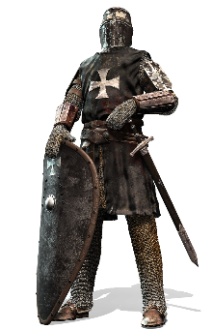
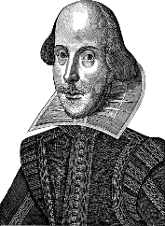
One-dimensional teams
Notes:
Imagine a party of warrior fighters who are all very strong. Could take on the king’s guard with no problem.
<click>
Or a party of charismatic, clever, and witty bards. Not so strong, but could talk their way past the king’s guards with no problem.
There are some challenges each of these teams will excel at, but there are many other challenges these teams would have to avoid, or they will fail.
Now imagine you're on an engineering team at NASA. <click>

Slide 17

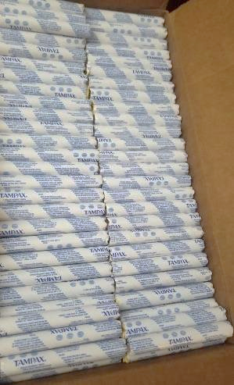
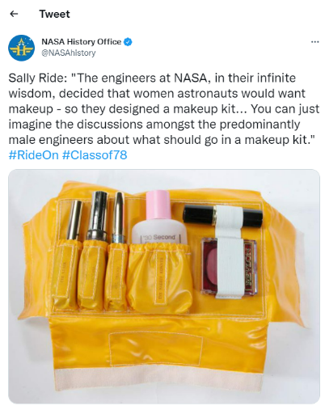

Diverse teams are better at solving problems
Notes:
And this team of NASA engineers is trying to figure out what Sally Ride, the first female shuttle astronaut, would need to bring with her, for 14 days in space.
Looking around the room, you realize the whole team is made up of male engineers.
That very real, very-not-diverse team of NASA engineers guessed – incorrectly - that Ride would need <click>100 tampons for just a 2-week trip and a <click>custom-designed face makeup kit in space. Now imagine what any woman would have told that team of engineers… if only they had the chance.
In a game, having a party with diverse skills is crucial, for needing to lift the castle's portcullis, or recognizing the poison dart trap, or identifying the mysterious symbols on the wall.
Similarly, a team of developers needs a broad range of talents to create a robust product for users. UX developers need different points of view to understand the user flow and journey through a digital experience, to create something that will help others achieve more. Backend developers also benefit from different perspectives to identify bugs and code vulnerabilities before they become problems.

Slide 18
Diversity matters to teams
Playing style
Diversity
Team member diversity
Character skill diversity
Team skill diversity
Notes:
And hey, that supports one of our core goals at Microsoft – building on the success of others.
At the gaming table and in the workplace, you should aim for a diversity of background, diversity of experience, and diversity of skillsets.
This not only creates a strong group of characters and co-workers, but also helps everyone on the team empathize with customers, ultimately doing better work in the long run.
This is why good companies cast wide nets in recruiting efforts, nets that avoid recruiting exclusively from elite schools, that include nontraditional candidates, candidates skilled through alternative routes, Historically Black Colleges and Universities, career switchers, veterans, international candidates. The best teams have a variety of backgrounds and lived experiences, and are better able to view problems from a variety of lenses, not just the lens of a dominant majority.

Slide 19
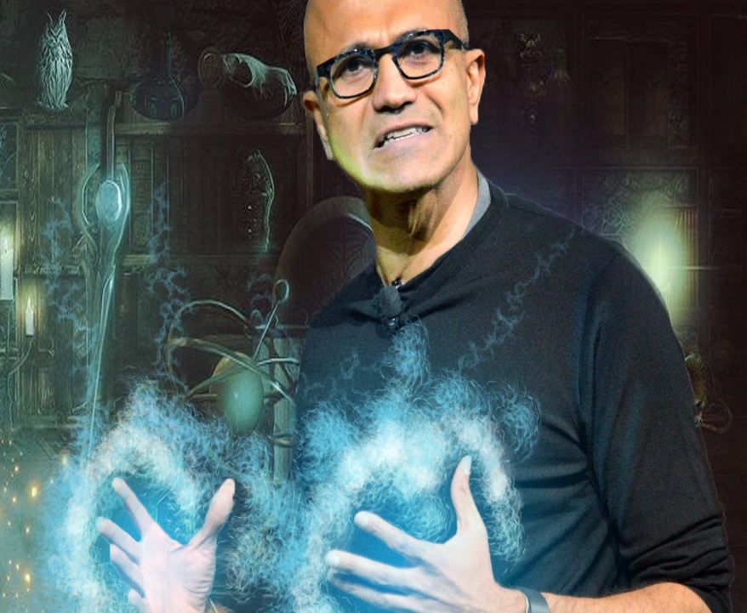
“It’s difficult to build technology that serves the world without first building a team that reflects the diversity of the world… A more diverse group of researchers and engineers is more likely to recognize and think harder about bias problems that may even impact them personally.”
Brad Smith, Microsoft President Tools and Weapons (2019)
Notes:
Microsoft’s own President, Brad Smith, wrote in his 2019 book, It’s difficult to build technology that serves the world without first building a team that reflects the diversity of the world… A more diverse group of researchers and engineers is more likely to recognize and think harder about bias problems that may even impact them personally.

Slide 20
Psychological safety in teams and at gaming tables
Feeling included
Crucial to collaborative creation
Often taken for granted by members of the majority
Focus on solutions, not blame
Safety to Challenge and Create
Safety to Learn and Grow
Inspired by a slide from the CSE Allyship Conversations
Notes:
A final note on why diversity matters to individuals on teams and at gaming tables.
Psychological safety is crucial.
As William mentioned earlier, psychological safety is near the top of the Maslow hierarchy. Psychological safety is a social environment, where everyone feels included and safe to learn, contribute, and create. We can't improvise or innovate if we don't feel safe.
Un-inclusive or discriminatory behaviors -- like for example, casual misogyny in jokes -- leads to exclusion, which leads to a lack of psychological safety. And that stifles creativity and productivity. It may mean that someone may weigh their participation against that discomfort, and participate only uncomfortably, if at all. I don't think anyone actively wishes our team members to be uncomfortable when they join us, so it's important to recognize the value they bring to the team and be sure we're welcoming and inclusive.
Psychological safety is one of those things that the majority may take for granted - in many spaces in my field of information technology, some may take for granted that they'll be in the majority of various social circles. For me, I’ve definitely felt the anxieties that my performance will be a reflection of my gender or other parts of my identity, whereas other people may not feel the same pressures.
Of course, it’s possible for anyone to feel they aren’t psychologically safe, depending on the environment, management expectations, interactions with our peers, or physical insecurities.
We won’t spend too much more time here, but for example, your project post-mortems, retroactive meetings, discovery sessions, and troubleshooting root cause analysis should not point fingers.
Focus on solutions instead of blame-storming. This creates an environment where mistakes are safe, where penalties and embarrassment aren’t needed, and where we're free to create and try, we're free to roll a 1 … and instead of bashing the dragon with our axe, we stub our toe. And everyone learns and laughs and has a great story to tell, and we move on.
I’ll now pass it off to Nina to tell us more about design thinking and how this skill can be leveraged in work and in life.

Slide 21
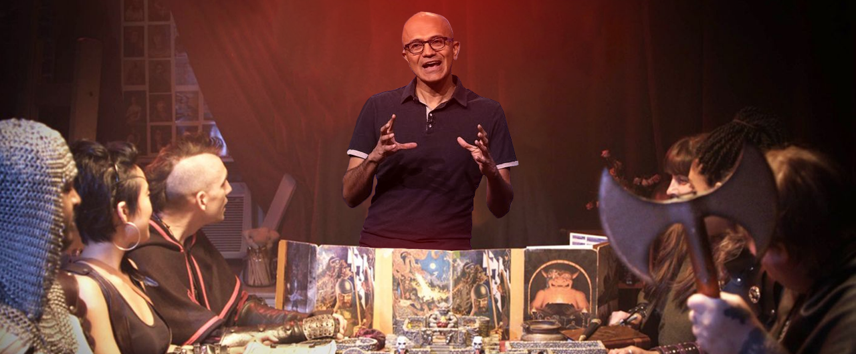
Design Thinking
Teamwork | Professional Communication | Diversity | Design Thinking | Q&A
Notes:
<nina>
This is why we’ve been talking about empathy in gaming, in teams, in teamwork, on the necessity of diverse teams.
Design Thinking is not just a way to transform a business it also rooted in tabletop games core skill set.

Slide 22
What is design thinking?
Also associated with:
Human-centered design
User-centered design
Strategic design
Design-based learning
Empathy
Who is this for?
What will they use it for?
When will they use it?
Why will they use it?
How will they use it?
Notes:
But what is design thinking? <click>
Design thinking, also commonly paired with human- or user-centered design, strategic design, and design-based learning, is a process we all can use to improve the content, products, and games we play. As Wikipedia so eloquently puts it: "The process [of design thinking] may also be thought of as a system of overlapping spaces rather than a sequence of orderly steps... Projects may loop back through inspiration, ideation, and implementation more than once as the team refines its ideas and explores new directions."
Design thinking puts an emphasis on the holistic experience we're designing. Whether that's writing documentation for engineers, designing a new feature for users, or telling a story for our friends, design thinking is a thought-framework we can use to make a better experience for everyone.
And to make a better experience, we need to empathize. We need to be able to consider: "What have the engineers made?" Or "What audience is this new feature for?" Or "Why am I telling my friends this story?" <click>
And paramount to design thinking is empathy. As we work with other people in almost any context, we need to be able to put ourselves in their shoes. By asking ourselves who, what, when, why, and how, we can craft better experiences. <click>

Slide 23
Empathy
Teamwork
Empathy
Professional communication
Diversity
Notes:
And empathy is needed in almost every aspect of our work. Whenever we're collaborating or presenting, we should empathize. Consider the audience or player's experiences and problems, successes and achievements, and gauge their expectations to design a better experience for everyone.
And now over to William—can we get better at practicing empathy?
<transition to William for 1 slide>

Slide 24
Practicing empathy
Skill sets of emotional intelligence
Self-awareness
Self-control
Motivation
Interpersonal skills
Empathy
Emotional intelligence is "self-mastered“. Empathy can be practiced.
Adult learners learn best when :
They set their own goals and have self-direction.
Enjoy the learning
Are problem solving
See the training as applicable.
Notes:
<william>
Yes, we can get better at empathy! But how?
Dr Daniel Goleman is a psychologist who wrote the 1995 book Emotional Intelligence, which started to popularize the idea. The 5 skill sets of emotional intelligence are self-awareness, self-control, motivation, interpersonal skills and empathy. In this context, empathy means being able to read and recognize the emotions of others and respond to them appropriately.
<click>
The researchers indicated that emotional intelligence is "self-mastered" – it can be learned; through education and practice, a person can learn empathy and the other emotional intelligence skills.
So the short answer is: Yes! Empathy can be practiced, can you can get better by practicing.
<click>
So what does this have to do with gaming?
In instructional design, years of research have shown us that adult learners learn best when :
They set their own goals and have self-direction.
Enjoy the learning
Are problem solving
And see the training as applicable.
Sound familiar? <Nina>

Slide 25
Practicing empathy through TTRPGs
Adult learners learn best when:
Setting personal goals
Quests, campaigns, and adventures
Having self-direction
Open-world exploration
Enjoy the learning
A fun time playing!
Problem solving
Literally puzzles, or combat, or other situations to navigate
Understanding how training is applicable
Playing with intention
Notes:
<nina>
There are countless parallels between empathy and table-top roleplaying games.<click>
As William just outlined, there are a few ways that help adult learners, or players, learn better. <click>
Players can set personal goals like quests, or complete bigger goals like campaigns.<click>
Players have self-direction in TTRPGs since most of them revolve around one grand idea: a game where you can do anything.<click>
Players enjoy the learning since everyone chooses to join the gaming table, and wants to play their characters.<click>
Players are constantly problem solving, whether that's literally puzzles they need to figure out to open a door, or competing in combat, or even engaging in dialogue with other characters—players are problem solving all over the fictional and real world.<click>
Lastly, and most importantly, to use TTRPGs to build empathy, all players should go in with the understanding that they are playing with the intention of practicing empathy. Some players play these games to build the strongest or smartest characters, but that's not what we're here to do—to build empathy while playing TTRPGs, go into the game wanting to empathize with your character specifically. Then, after you've gotten used to that, try empathizing with the other characters. Why might they be making the decisions they are? Why should one character get the chance to talk to the royalty while others might not? By playing a TTRPG, we add a level of abstraction to empathy that makes it easier to talk about why characters may do certain things.
These skills are transferrable, and not limited to TTRPGs-- many of you may have personal hobbies like fishing, or knitting, or painting. And in a study from 2014, organizational psychologists studied a group of workers who spent significant time on hobbies and a group who didn’t and they noted a significant difference in recovery experiences (i.e., control and relaxation) and performance-related outcomes (i.e., job creativity and extra-role behaviors). We think what this tells us is that we tend to bring all our skills to work--we’re not partitioned, and what we learn personally can help us professionally.
And just like any other skill, practice and learning through experience is necessary before we can create and improvise ourselves.
We must take time to learn the rules of Dungeons and Dragons before we can play, and similarly we have to learn how to empathize and how to practice empathy.
<click>

Slide 26
“Learning how people adapt to the world around them means spending time understanding their experience from their perspective.
When done well, we can recognize more than just the barriers people encounter. We also recognize their motivations that all people have in common.”
Microsoft Design Inclusive toolkit
Notes:
<nina>
That’s the core of our message today, that as players and storytellers at tabletop games, we can get better at empathy, and that makes us better at our real life jobs at Microsoft or elsewhere. This quote from the Microsoft Design Inclusive toolkit wraps us up nicely, emphasizing that when we empathize with others, we not only recognize their barriers, but also their shared, common motivations.

Slide 27
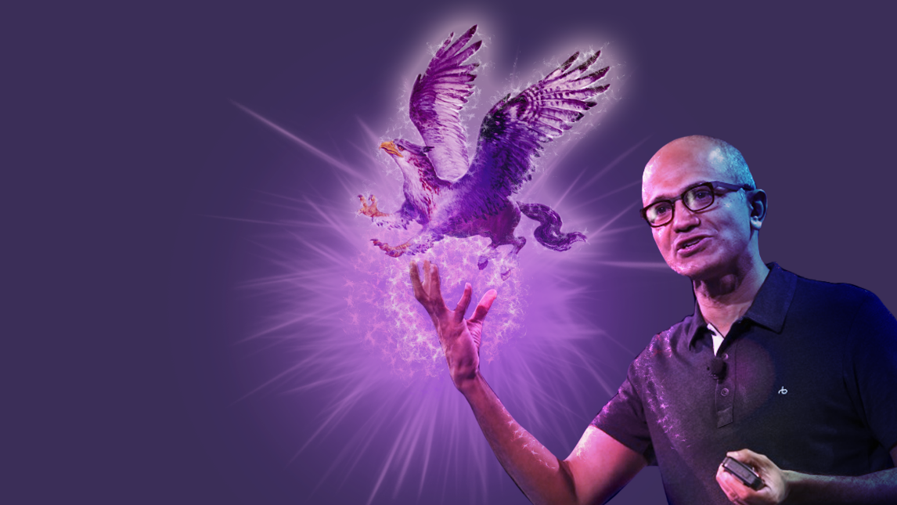
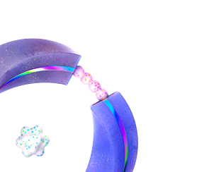
Q&A
Teamwork | Professional Communication | Diversity | Design Thinking | Q&A
Notes:
<nina>
So, we hope you’ve had as much fun today as we have, and we hope you’re inspired to start your own RPG tables at work or at home.
If you have any questions, feel free to raise your hand or put it in chat! Let's talk :)
-What other parallels to do you see between what skills we have in gaming and at work?
-What other benefits do you see from running TTRPGs that translate to our work?

